Slide 1
Introduction to SQL Server
Chapter 6
Creating Multitable Queries - Join
6-<number>

Slide 2
Before we get started … just an FYI
SQLite is an in-process library that implements a self-contained,serverless, zero-configuration, transactional SQL database engine. The code for SQLite is in the public domain and is thus free for use for any purpose, commercial or private. SQLite is the most widely deployed database in the world
6-<number>

Slide 3
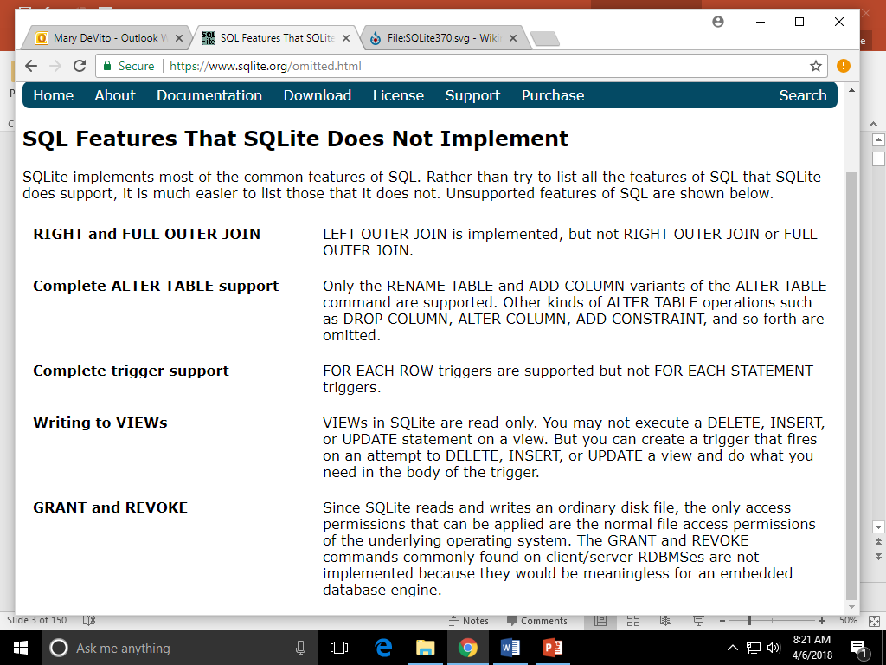
6-<number>

Slide 4
A statement-level trigger would look like this:
create trigger stmt_level_trigger
after update on Highschooler
begin
update Highschooler
set grade = NULL
where grade = 13;
end;
and a row-level trigger would look like this:
create trigger row_level_trigger
after update on Highschooler
for each row
when New.grade = 13
begin
update Highschooler
set grade = NULL
where New.ID = Highschooler.ID;
end;
Note that SQLite doesn't support statement-level triggers,
6-<number>

Slide 5
Just a reminder
Scope identity info
Make sure to set is identity to yes for the primary key in the table
declare @holdit int;
insert into agents (firstname) values ('mary');
set @holdit = scope_identity();
print @holdit
6-<number>

Slide 6
Chapter Outline
Creating and Using Multitable Queries
  Joining Tables Having Matching Column Values
  Understanding Other Join Types and Join Conditions
  Using Subqueries (query within a query)
6-<number>

Slide 7
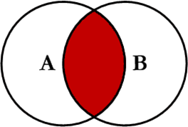
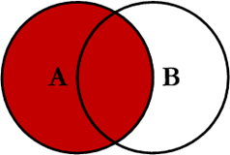
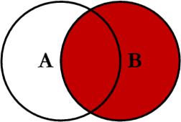
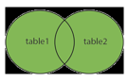
Joins – just a reminder of how they work Quick Review
Inner – joining of 2 or more tables that returns only rows that satisfy the join condition
Outer - - returns a row when a join conditions are met and even when one of the join column conditions is null … inner join plus
  Left
  Right
  Full Outer join
6-<number>

Slide 8
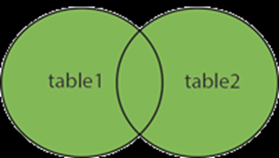
6-<number>

Slide 9
Format - Inner Join
Select fieldnames …
from table1name
Join table2name
on table1name.fieldname = table2name.fieldname
Primary and foreign keys
Select fieldnames …
from table1name
Join table2name
on table1name.fieldname = table2name.fieldname
where …. fieldname =
… Answer next slide
6-<number>

Slide 10
Let’s take a look at an example from the beginning of the semester
6-<number>

Slide 11
Joining two tables Having Matching Column Values (inner join) the employee and their sales
Employees
Sales
ID | Name | Div
1001 | Bob | Mkt
1002 | Dawn | Sales
1003 | Betty | Sales
1006 | Nancy | Mkt
1009 | Fred | Sales
PK2 | Emp# | Amount
21 | 1002 | $2,000
22 | 1002 | $2,200
23 | 1003 | $1,800
24 | 1003 | $200
25 | 1009 | $600
26 | 1009 | $750
27 | 1009 | $425
PK FK
Select fieldnames …
from table1name
Join table2name
on table1name.fieldname = table2name.fieldname
What would the resulting table look like do it on a piece of paper
6-<number>

Slide 12
6.1 Joining two tables Having Matching Column Values
Result of joining the Employees and Sales tables:
from Employees from Sales
1002 Dawn Sales 21 1002 $2,000
1002 Dawn Sales 22 1002 $2,200
1003 Betty Sales 23 1003 $1,800
1003 Betty Sales 24 1003 $200
1009 Fred Sales 25 1009 $600
1009 Fred Sales 26 1009 $750
1009 Fred Sales 27 1009 $425
6-<number>

Slide 13
Review Redwood Reality
Handout
6-<number>

Slide 14
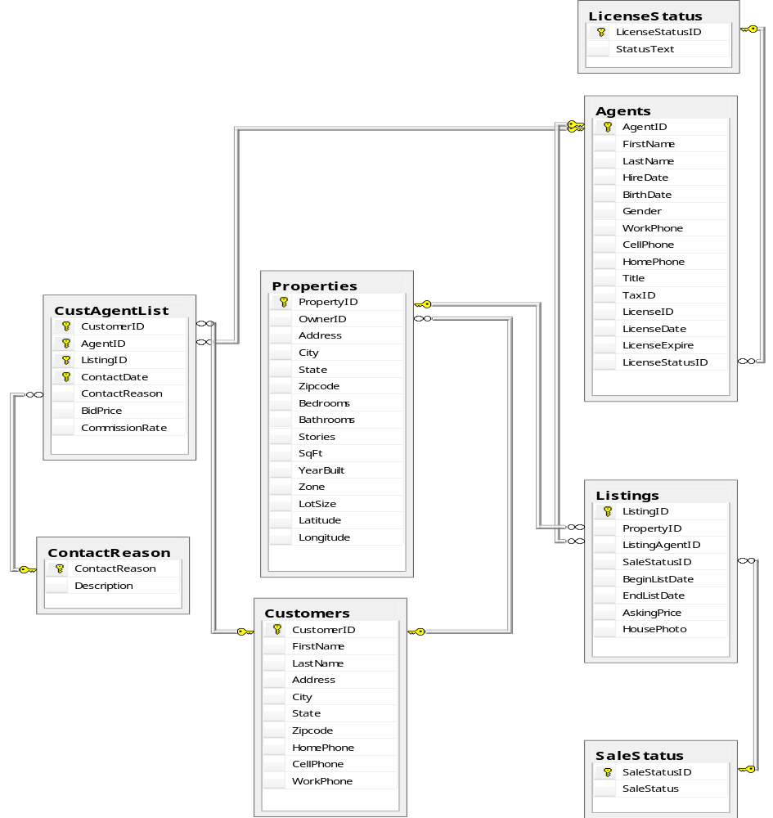
6-<number>

Slide 15
Inner Join
6-<number>

Slide 16
Let’s say you want to find out …
What customers Own properties ? You want to do select *
6-<number>

Slide 17
Start by Join tables, look at what links the tables together --- their relationships PK-FK
6-<number>

Slide 18
What 2 tables if joined would give you this information ?
6-<number>

Slide 19
Customers and Properties what fields link the tables together (FK) and (PK)?
6-<number>

Slide 20
Relation between the 2 tables is the foreign key and the primary key
6-<number>

Slide 21
Customers.customerID and Properties.Ownerid this is what the join will use
6-<number>

Slide 22
Recall the Format of the – Inner Join
Select fieldnames …
from table1name
Join table2name
on table1name.fieldname = table2name.fieldname
Select fieldnames …
from table1name
Join table2name
on table1name.fieldname = table2name.fieldname
where …. fieldname =
… Answer next slide
6-<number>

Slide 23
Joining the Customers and Properties tables
Select * from Customers JOIN Properties on Customers.CustomerID = Properties.OwnerID
Relationship between the 2 tables
When you use join it assumes inner join.
This join Answers the question: What customers Own property
6-<number>

Slide 24
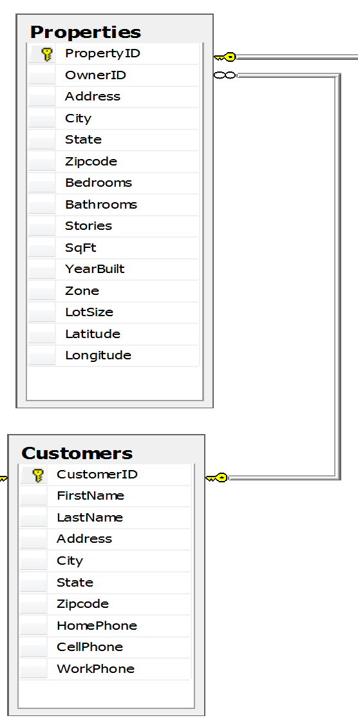
One thing you need to know … What if the tables you join have the same fieldname for example the address in properties and the address in customers
….
You just need to indicate which one you want … that way the system knows
Customers.Address Properties.Address
6-<number>

Slide 25
Let’s say you want to find out …
What customers Own properties ? You want to know: the customer’s firstname the customer’s last name the address of the property the city the property is in
6-<number>

Slide 26
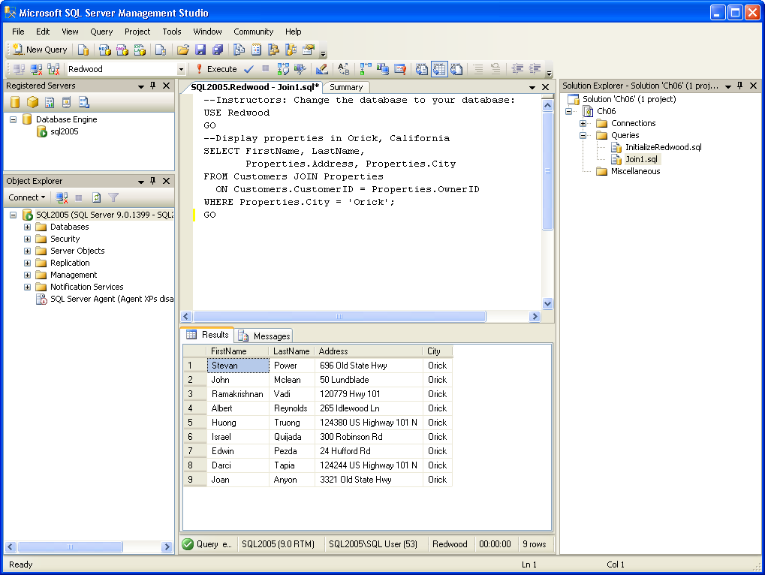
6-<number>

Slide 27
Now join the 2 tables and answer the question …
What customers Own properties in Orick?
Answer Next Slide
6-<number>

Slide 28
6.3 Joining the Customers and Properties tables
Relationship between the 2 tables
This join Answers the question What customers Own property In Orick ?
6-<number>

Slide 29
Joining 3 tables
Sql first joins 2 of the tables based on the join condition, then it joins the results to another table based on the join condition
Select fieldnames
From table1name
join table2name On table1.relationashipfieldname =
table2.relationshipfieldname
Join table3name On table1or2.relationashipfieldname =
table3.relationshipfieldname
Where …… optional
6-<number>

Slide 30
Let’s try this one, let’s go through it one step at a time
You want the first and last name of agents and the list of properties they are listing, more specifically the property information you want to know is:
  location (address, city),
  # of bedrooms,
  # of bathrooms
  asking price
for each listing
Ask Yourself … what tables do you need … look at the fields of information you want: agents FN and LN, address, city, bedrooms, bathrooms, askingprice … this will tell you the tables you need and how to join them
… see next slide for the answer
6-<number>

Slide 31
Agents Properties Listing
agents FN and LN, address, city, bedrooms, bathrooms, askingprice
6-<number>

Slide 32
Question
Could you go directly from Agents to Properties ?
Answer Next Slide
6-<number>

Slide 33
No, there is no directly link, but you can get there through the listings table
6-<number>

Slide 34
Agents, Listing & Properties what fields link the tables together ?
Look at the diagram on the next slide
6-<number>

Slide 35
6-<number>

Slide 36
Agents.agentid, Listing.listingagentid listing.propertyid, Properties.propertyid format for joining 3 tables on next slide
6-<number>

Slide 37
Format
Select fieldnames
From table1name
join table2name On table1.relationashipfieldname = table2.relationshipfieldname
Join table3name On table2.relationashipfieldname = table3.relationshipfieldname
Where …… optional
Now that you have all of the information. Write a query to:
List agents first and last name , their listing properties location (address, city), bedroom & bathroom and the asking price for that listing
Answer next slide
6-<number>

Slide 38
select firstname, lastname, address, city, bedrooms, bathrooms, askingprice from agents join listings on agents.agentid = listings.listingagentid join properties on listings.propertyid = properties.propertyid
6-<number>

Slide 39
Now order the resulting table by city
Answer Next Slide
6-<number>

Slide 40
select firstname, lastname, address, city, bedrooms, bathrooms,
askingprice
from agents
join listings on agents.agentid = listings.listingagentid
join properties on listings.propertyid = properties.propertyid
Order by city
6-<number>

Slide 41
Now lets learn what an alias is
Alias is just a short hand for a table name, an example is on the next slide
6-<number>

Slide 42
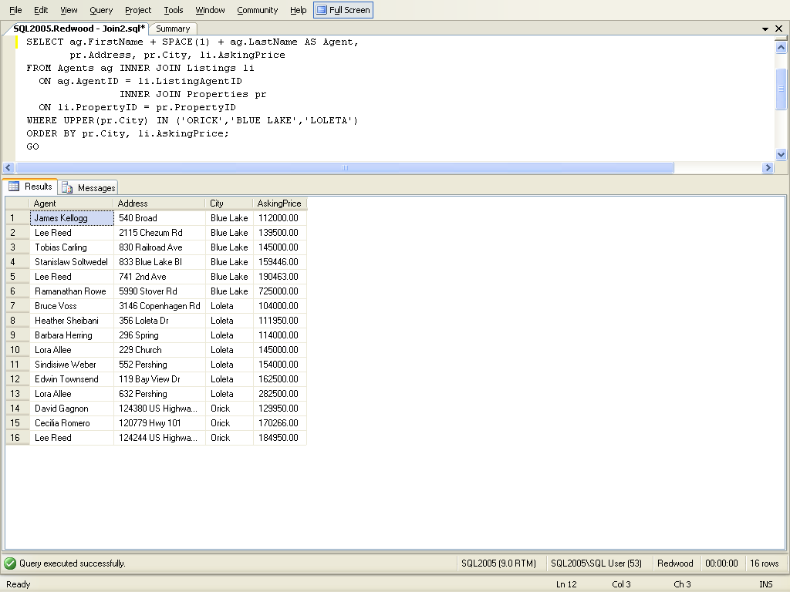
Create an alias
Alias is just a short hand for a table name
6-<number>

Slide 43
Now use alias and add to the pervious command the ability to order by city and asking price, and we are also only interested in the following cities: orick, blue lake, loleta
Write the Query - Answer Next Slide
6-<number>

Slide 44
Create an alias
Alias is just a short hand for a table name
6-<number>

Slide 45
Same command … just cleaner look
select ag.Firstname, ag.lastname, pr.address, pr.city, li.askingprice
from agents ag
join listings li on ag.agentid = li.listingagentid
join properties pr on li.propertyid = pr.propertyid
where upper(pr.city) in ('ORICK','BLUE LAKE','LOLETA')
order by pr.city, li.askingprice
6-<number>

Slide 46
Same command … just cleaner look
select ag.Firstname, ag.lastname, pr.address, pr.city, li.askingprice
from agents ag
join listings li on ag.agentid = li.listingagentid
join properties pr on li.propertyid = pr.propertyid
where upper(pr.city) in ('ORICK','BLUE LAKE','LOLETA')
order by pr.city, li.askingprice
This works also
select ag.Firstname, ag.lastname, pr.address, pr.city, li.askingprice
from agents ag
join listings li on ag.agentid = li.listingagentid
join properties pr on li.propertyid = pr.propertyid
and upper(pr.city) in ('ORICK','BLUE LAKE','LOLETA')
order by pr.city, li.askingprice
(** the second approach is suppose to be faster **)
6-<number>

Slide 47
Join more then 3 tables
Sql first joins 2 of the tables based on the join condition, then it joins the results to another table based on the join condition, this process continues until all tables are joined into the resulting temporary table
6-<number>

Slide 48
What if you want to know:
---- houses that are listed (sale, pending, or sold)
---- number of bedrooms,
---- number of bathrooms,
---- sq ft,
---- owner of the property (firstname and lastname),
---- agent’s name that is listing the properties wps.prenhall.com/bp_perry_sql2005_1 let’s take a look at the tables we need, next slide
6-<number>

Slide 49
Customers – buyers and/or sellers who have contacted the company
Properties – detail about properties in the listing and customers table
Listings – properties for sale
try to write the query, sol’n next slide

Slide 50
Note: INNER JOIN and JOIN mean the same thing
SELECT * FROM
Listings
INNER JOIN Properties on Properties.PropertyID = Listings.PropertyID
INNER JOIN Customers on Customers.CustomerID = Properties.OwnerID
INNER JOIN Agents on Agents.AgentID = Listings.ListingAgentID or
SELECT * FROM
Listings
INNER JOIN Agents on Agents.AgentID = Listings.ListingAgentID
INNER JOIN Properties on Properties.PropertyID = Listings.PropertyID
INNER JOIN Customers on Customers.CustomerID = Properties.OwnerID
6-<number>

Slide 51
Let’s try another one
What if you are only interested in knowing this for listings that are for sale, query must use “For Sale” not 101. sol’n next slide
6-<number>

Slide 52
SELECT * FROM Listings
INNER JOIN Properties on Properties.PropertyID = Listings.PropertyID
INNER JOIN Customers on Customers.CustomerID = Properties.OwnerID
INNER JOIN Agents on Agents.AgentID = Listings.ListingAgentID
INNER JOIN Salestatus on listings.salestatusID=salestatus.salestatusid
WHERE salestatus.salestatus = ”For Sale” or
SELECT * FROM Listings
INNER JOIN Properties on Properties.PropertyID = Listings.PropertyID
INNER JOIN Customers on Customers.CustomerID = Properties.OwnerID
INNER JOIN Agents on Agents.AgentID = Listings.ListingAgentID
INNER JOIN Salestatus on listings.salestatusID=salestatus.salestatusid and salestatus.salestatus = ”For Sale”
6-<number>

Slide 53
Always ask yourself:
--- where is the data I need, what table is it in
--- how are the tables connected
6-<number>

Slide 54
There are 502 homes in the listings table (some of the listings are sold, some are pending) only interested in the ones For Sale and let’ say that you want to
gather information about those home: more specifically you are interested
In knowing the following information:
The first and last name of the listing agent for the seller,
the asking price for the house,
the first and last name of the customer that wants to buy the house
Any bids that were made on the house, remember some customers want to sell their house that is why they contacted the agent
The address of the house, city where the house is, the number of bedrooms
& bathrooms and the sqft of the house
The first thing you have to figure out is what tables are the fields of information located In ….. Take a minute to look. Sample output next slide
6-<number>

Slide 55
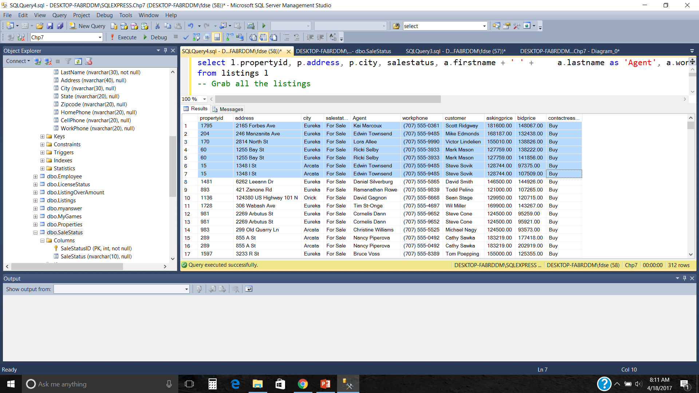
6-<number>

Slide 56
CustAgentList
CustomerID AgentID ListingID ContactDate ContactReason BidPrice CommissionRate
31316 13649 15532 2006-09-25 00:00:00.000 Sell NULL 0.0600
31330 15061 15297 2006-08-15 00:00:00.000 Sell NULL 0.0600
31357 14117 15062 2006-07-06 00:00:00.000 Sell NULL 0.0600
31384 10913 15146 2006-07-22 00:00:00.000 Sell NULL 0.0600
31386 14117 15100 2006-07-13 00:00:00.000 Sell NULL 0.0600
31407 10849 15005 2006-08-05 00:00:00.000 Buy 101384.00 0.0000
31407 10849 15005 2006-08-17 00:00:00.000 Buy 116374.00 0.0000
31407 10913 16049 2006-12-10 00:00:00.000 Sell NULL 0.0600
Note: you have to check the salestatus, some bids might be on houses that sold. The real estate agent keeps all data, that helps them determine sale prices for new
homes
6-<number>

Slide 57
Customers – buyers and sellers who have contacted the company
Properties – detail about properties in the listing and customers table
CustAgentList – binds the Customer, Agent and the Listings table together, price that buyers have bid on a property, contact reason Buy; if contract reason sell, means you want to sell/list your house
Listings – properties for sale
6-<number>

Slide 58
Where do I join these tables, PK AND FK
Try to write the query – Solution Next slide
Salestatus
© 2007 by Prentice Hall
6-<number>
6-<number>

Slide 59
select l.propertyid, p.address, p.city, salestatus, a.firstname + ' ' + a.lastname as 'Agent', a.workphone, c.firstname + ' ' + c.lastname as customer, askingprice, bidprice, contactreason
from listings l
join properties p on p.propertyid = l.propertyid
join custagentlist cal on cal.listingid = l.listingid
join customers c on c.customerid = cal.customerid
join salestatus s on l.salestatusid = s.salestatusid
join agents a on a.agentid = l.listingagentid
where salestatus = 'For Sale' and bidprice > 0
6-<number>

Slide 60
Explanation Next slide
6
2
3
1
4
Try to write the query – Solution Next slide
5
Salestatus
© 2007 by Prentice Hall
6-<number>
6-<number>

Slide 61
select l.propertyid, p.address, p.city, salestatus, a.firstname + ' ' + a.lastname as 'Agent', a.workphone, c.firstname + ' ' + c.lastname as customer, askingprice, bidprice, contactreason
from listings l
-- Grab all the listings
join properties p on p.propertyid = l.propertyid
--Link the property to each listing
join custagentlist cal on cal.listingid= l.listingid
-- Get the customers, agents & bids for each property currently listed
join customers c on c.customerid = cal.customerid
-- Get the customer that bid on the listing
join salestatus s on l.salestatusid = s.salestatusid
-- Get the sale status of the listing
join agents a on a.agentid = l.listingagentid
-- Get the agent listing the property
where salestatus = 'For Sale' and bidprice > 0 -- Make sure its still for sale, and a null bid price is when they are selling the property so that rules those CustAgentListing rows out
6-<number>

Slide 62
What if you also want to know who the customer is that is selling/listing the house. How to you change the sql command you just wrote. see sample output next slide
6-<number>

Slide 63
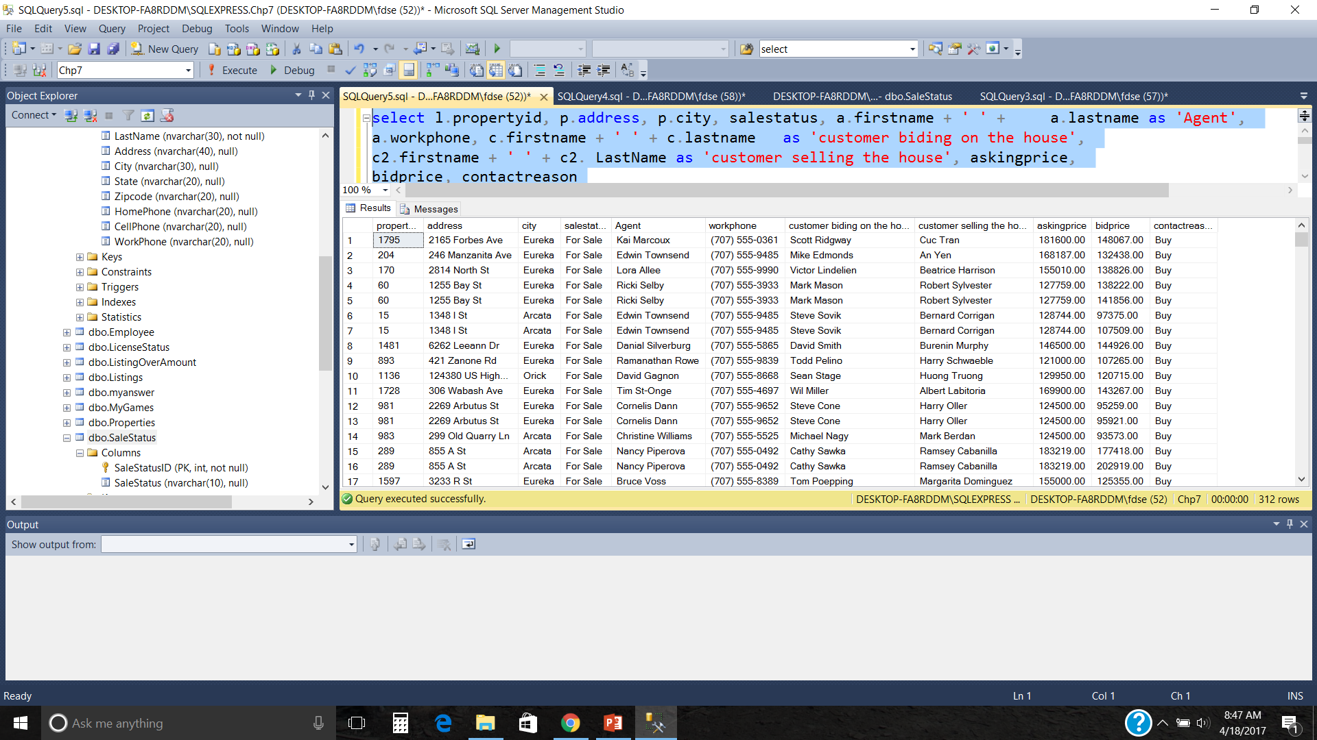
Answer next slide
6-<number>

Slide 64
select l.propertyid, p.address, p.city, salestatus, a.firstname + ' ' + a.lastname as 'Agent', a.workphone, c.firstname + ' ' + c.lastname as 'customer biding on the house', c2.firstname + ' ' + c2. LastName as 'customer selling the house', askingprice, bidprice, contactreason
from listings l
join properties p on p.propertyid = l.propertyid
join custagentlist cal on cal.listingid= l.listingid
join customers c on c.customerid = cal.customerid
-- get the name of the customer listing the house
join customers c2 on c2.customerid = p.OwnerID
join salestatus s on l.salestatusid = s.salestatusid
join agents a on a.agentid = l.listingagentid
where salestatus = 'For Sale' and bidprice > 0
6-<number>

Slide 65
What if you did these sql commands
SELECT Agents.FirstName, Agents.LastName, AskingPrice, Customers.FirstName, Customers.LastName, Properties.Address, Properties.City, Properties.Bedrooms, Properties.Bathrooms, Properties.SqFt,
CustAgentList.BidPrice
FROM Listings
JOIN Properties on Properties.PropertyID = Listings.PropertyID
JOIN Customers on Customers.CustomerID = Properties.OwnerID
JOIN CustAgentList on Customers.CustomerID = CustAgentList.CustomerID
JOIN Agents on Agents.AgentID = Listings.ListingAgentID
JOIN SaleStatus on Listings.SaleStatusID = SaleStatus.SaleStatusID
Where SaleStatus = 'For Sale' and BidPrice > 0
Commands on D2L in folder called JoinAnalysis
6-<number>

Slide 66
SELECT Agents.FirstName, Agents.LastName, AskingPrice, Customers.FirstName, Customers.LastName, Properties.Address, Properties.City, Properties.Bedrooms, Properties.Bathrooms, Properties.SqFt,CustAgentList.BidPrice, CustAgentList.ContactReason
FROM Listings JOIN Properties on Properties.PropertyID = Listings.PropertyID
JOIN Customers on Customers.CustomerID = Properties.OwnerID
JOIN CustAgentList on Customers.CustomerID = CustAgentList.CustomerID
--what you are doing here is wrong, the customers.customerid
–-represents the owner of the house (from previous joins), so when you --join with CustAgentList.CustomerID (that is suppose to be the
--customer bidding on the house)
JOIN Agents on Agents.AgentID = Listings.ListingAgentID
JOIN SaleStatus on Listings.SaleStatusID = SaleStatus.SaleStatusID
Where SaleStatus = 'For Sale' and BidPrice > 0
--look at excel sheet joinanalysis
6-<number>

Slide 67
Let’s practice joins on the Coffee Database
6-<number>

Slide 68
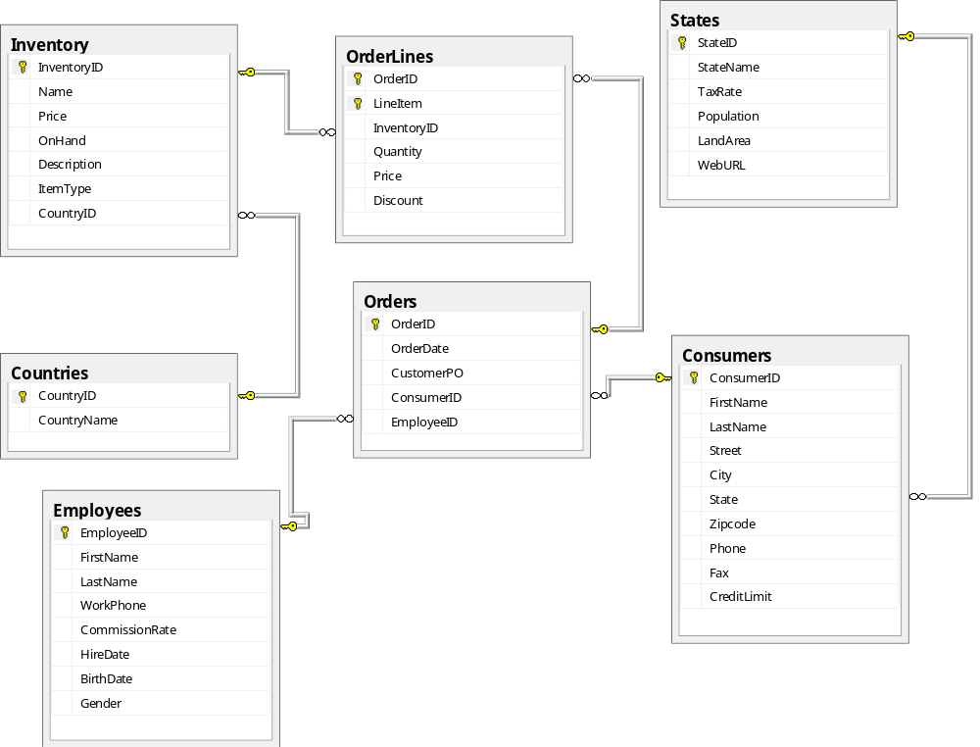
more joins lets use the Coffee DB, try these Coffee DB and loading out instructions on D2l in folder called “Loading Coffee DB into Sql Server’ and ‘Coffee Database Chapter 7
Customers makes orders, orders can have several line items (an order can have multiply items on one order). An employee is responsible for each order
6-<number>

Slide 69
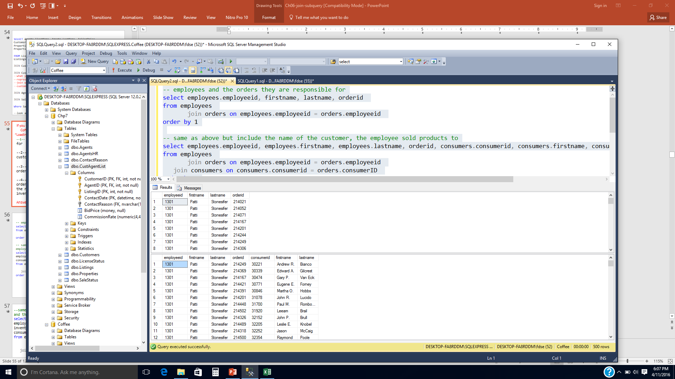
--1-- employees (employeeID, first name, lastname) and the ordered(s) they are responsible for, order by employeeID
Answer
next
slide
6-<number>

Slide 70
-- employees and the orders they are responsible for
select employees.employeeid, firstname, lastname, orderid
from employees
join orders on employees.employeeid = orders.employeeid
order by 1
6-<number>

Slide 71
--1-- employees and the orders they are responsible for
--2-- same as above but include the name of the customer the employee sold items/products to
Answer
next
slide
6-<number>

Slide 72
-- employees and the orders they are responsible for
select employees.employeeid, firstname, lastname, orderid
from employees
join orders on employees.employeeid = orders.employeeid
order by 1
-- same as above but include the name of the customer the employee sold products to
select employees.employeeid, employees.firstname, employees.lastname, orderid, consumers.consumerid, consumers.firstname, consumers.lastname
from employees
join orders on employees.employeeid = orders.employeeid
join consumers on consumers.consumerid = orders.consumerID
order by 1
6-<number>

Slide 73
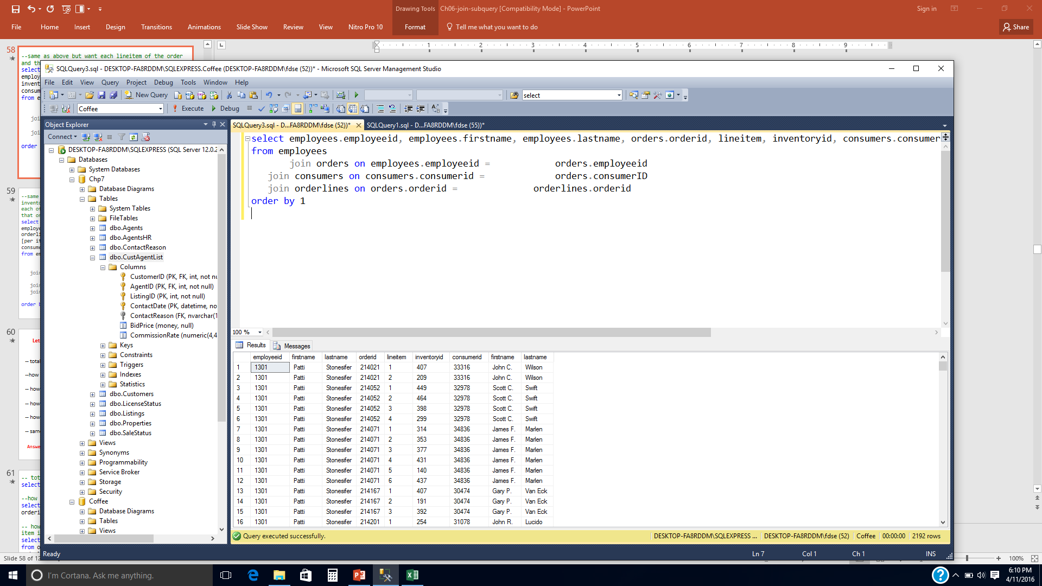
--3--same as above but you want each lineitem of the order and the inventoryID for that lineitem
Answer next slide
Represents one order that has 4 items
6-<number>

Slide 74
--same as above but want each lineitem of the order and the inventoryID for that lineitem
select employees.employeeid, employees.firstname, employees.lastname, orders.orderid, lineitem, inventoryid, consumers.consumerid, consumers.firstname, consumers.lastname
from employees
join orders on employees.employeeid = orders.employeeid
join consumers on consumers.consumerid = orders.consumerID
join orderlines on orders.orderid = orderlines.orderid
order by 1
6-<number>

Slide 75
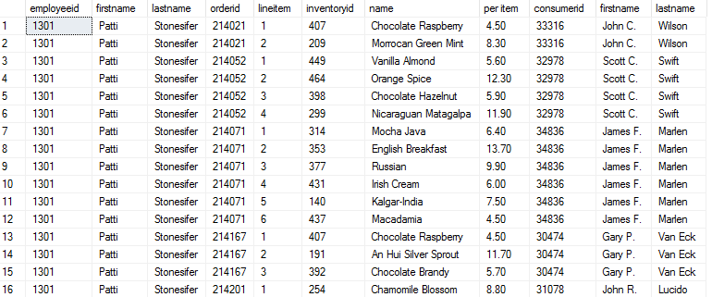
--4--same as above but want each lineitem of the order and the inventoryID for that lineitem and the name and price for each of the items in inventory that is being purchased for that order
Answer next slide
6-<number>

Slide 76
--same as above but want each lineitem of the order and the inventoryID for that lineitem and the name and price for each of the items in inventory that is being purchased for that order
select employees.employeeid, employees.firstname, employees.lastname, orders.orderid, lineitem, orderlines.inventoryid, inventory.name, orders.price as
[per item], consumers.consumerid, consumers.firstname, consumers.lastname
from employees
join orders on employees.employeeid = orders.employeeid
join consumers on consumers.consumerid = orders.consumerID
join orderlines on orders.orderid = orderlines.orderid
join inventory on inventory.inventoryid = orderlines.inventoryid
order by 1
6-<number>

Slide 77
Lets use the Coffee DB and try some old stuff that we learned
-- total num of lineitems
answer 2192
--how many items are in each order
  (No column ) orderid
  2192 NULL
  5 214010
  5 214011
  5 214012
  6 214013
  4 214014
  6 214015
  5 214016
Answers next slide
6-<number>

Slide 78
-- total num of lineitems
select count(lineitem) from orderlines
--how many different items are in each order
select count(*), orderid from orderlines group by orderid with rollup order by orderid
6-<number>

Slide 79
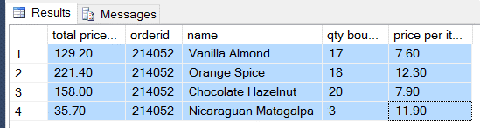
Lets use the Coffee DB and try some old stuff that we learned
-- what was the total cost of each item for ordered 214052, list the total price of each item, name of the item, qty bought and the price per item the customer paid (I included ordered, just to make sure I was getting all of the info)
Answers next slide
6-<number>

Slide 80
-- how much was order 214052 (total cost for each item in the order)
select orderlines.price*orderlines.quantity as [total price for this item], orderid, name, quantity as [qty bought],
orderlines.price as [price per item]
from orderlines join inventory on orderlines.InventoryID = Inventory.InventoryID
where orderlines.orderid = 214052
6-<number>

Slide 81
-- how much was the total cost of order 214052
total
544.30
Answers next slide
6-<number>

Slide 82
-- how much was the total cost of order 214052
select sum(orderlines.price*orderlines.quantity) from orderlines where orderid = 214052
6-<number>

Slide 83
Lets use the Coffee DB and try some old stuff that we learned
-- how much was the total cost for each of the orders
  total order ordered
  price
  688.70 214010
  430.10 214011
  313.70 214012
  514.50 214013
  562.20 214014
  294.80 214015
  171.30 214016
  233.70 214017
Answers next slide
6-<number>

Slide 84
-- who much was the total cost for each of the orders
select sum(orderlines.price*orderlines.quantity) as [total order price] , orderid from orderlines group by orderlines.orderid
6-<number>

Slide 85
Lets use the Coffee DB and try some old stuff that we learned
-- how much was the total cost for each of the orders
  total order ordered
  price
  688.70 214010
  430.10 214011
  313.70 214012
  514.50 214013
-- same as above but want the total cost for all orders
total order ordered
price
276.50 214504
498.70 214505
707.00 214506
380.60 214507
295.20 214508
591.40 214509
195708.40 NULL
Answers next slide
6-<number>

Slide 86
-- who much was the total cost for each of the orders
select sum(orderlines.price*orderlines.quantity) as [total order price], orderid from orderlines group by orderlines.orderid
-- same as above but want the total cost for all orders
select sum(orderlines.price*orderlines.quantity) as [total order price], orderid from orderlines group by orderlines.orderid with rollup
6-<number>

Slide 87
Outer Join
6-<number>

Slide 88
Venn diagrams showing inner join and left outer join
inner join
Only where there is a match between the 2 tables
left outer join
Include inner join + any no matches in the left table
selected rows
Sales-person
Sales
Sales-person
Sales
excluded rows
excluded rows
excluded rows
rows with matching values
(selected rows)
rows with matching values
6-<number>

Slide 89
Recall - INNER join
Salespersons
No matches in sales table
So they
Don’t end up
In the
result
Sales
ID | Name | Div
1001 | Bob | Mkt
1002 | Dawn | Sales
1003 | Betty | Sales
1006 | Nancy | Mkt
1009 | Fred | Sales
PK2 | Emp# | Amount
21 | 1002 | $2,000
22 | 1002 | $2,200
23 | 1003 | $1,800
24 | 1003 | $200
Result of joining the Salespersons and Sales tables:
from Salespersons from Sales
1002 Dawn Sales 21 1002 $2,000
1002 Dawn Sales 22 1002 $2,200
1003 Betty Sales 23 1003 $1,800
1003 Betty Sales 24 1003 $200
This only gives the list of salespeople that sold “stuff
6-<number>

Slide 90
What if you want a list of sales folks that sold stuff but you also want to include in that list the sales folks that didn’t sell anything … so they won’t have a match in the items sold table …. You need an outer join … we will write this query later in the real estate DB. First let’s review types of outer joins
Example of where an outer join would be helpful
Sales Folks
Items Sold
6-<number>

Slide 91
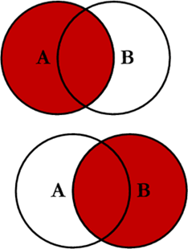
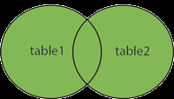
Outer Join
Outer - - returns a row when a join conditions are met and even when one of the join column conditions is null … inner join plus
  Left outer join
  Right outer join
  Full Outer join
6-<number>

Slide 92
There are 3 types of outer join
left outer – refers to the table on the left side in the FROM clause,
if there are unmatched rows in the left table,
then it should be matched with a NULL record
and returned in the results
2. Right outer – refers to the table on the right side in the FROM clause,
if there are unmatched rows in the right table,
then it should be matched with a NULL record
and returned in the results
3. Full outer - return rows from either table that do not have matching
rows in the other table along with those that do have matches
6-<number>

Slide 93
Left Outer join
No match in sales table
(Left Table) Salespersons
Sales (Right Table)
ID | Name | Div
1001 | Bob | Mkt
1002 | Dawn | Sales
1003 | Betty | Sales
1006 | Nancy | Mkt
1009 | Fred | Sales
PK2 | Emp# | Amount
21 | 1002 | $2,000
22 | 1002 | $2,200
23 | 1003 | $1,800
24 | 1003 | $200
Get a piece of paper and write down the result if you did a left outer join on the tables above

Slide 94
Left Outer join
No match in sales table
(Left Table) Salespersons
Sales (Right Table)
ID | Name | Div
1001 | Bob | Mkt
1002 | Dawn | Sales
1003 | Betty | Sales
1006 | Nancy | Mkt
1009 | Fred | Sales
PK2 | Emp# | Amount
21 | 1002 | $2,000
22 | 1002 | $2,200
23 | 1003 | $1,800
24 | 1003 | $200
Result of joining the Salespersons and Sales tables:
from Salespersons from Sales
1002 Dawn Sales 21 1002 $2,000
1002 Dawn Sales 22 1002 $2,200
1003 Betty Sales 23 1003 $1,800
1003 Betty Sales 24 1003 $200
1001 Bob Mkt null null null
1006 Nancy Mkt null null null
1009 Fred Sales null null null
Notice there are sales
people that have not
made any sales, every row in the left table ends up in the output unless you use the where clause to control that
6-<number>

Slide 95
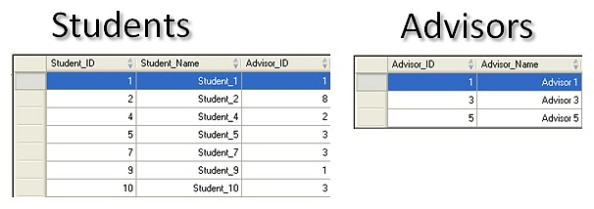
Full Out Join Example
What would the fuller outer join result be, do it on paper ? Answer Next Slide
It would tell you:
-- students that don’t have advisors
-- students that have advisors (advisors that have students)
-- advisors that don’t have students
6-<number>

Slide 96
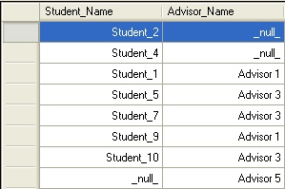
6-<number>

Slide 97
Let’s try some outer (Left, right, full) joins with our Real Estate Example
6-<number>

Slide 98
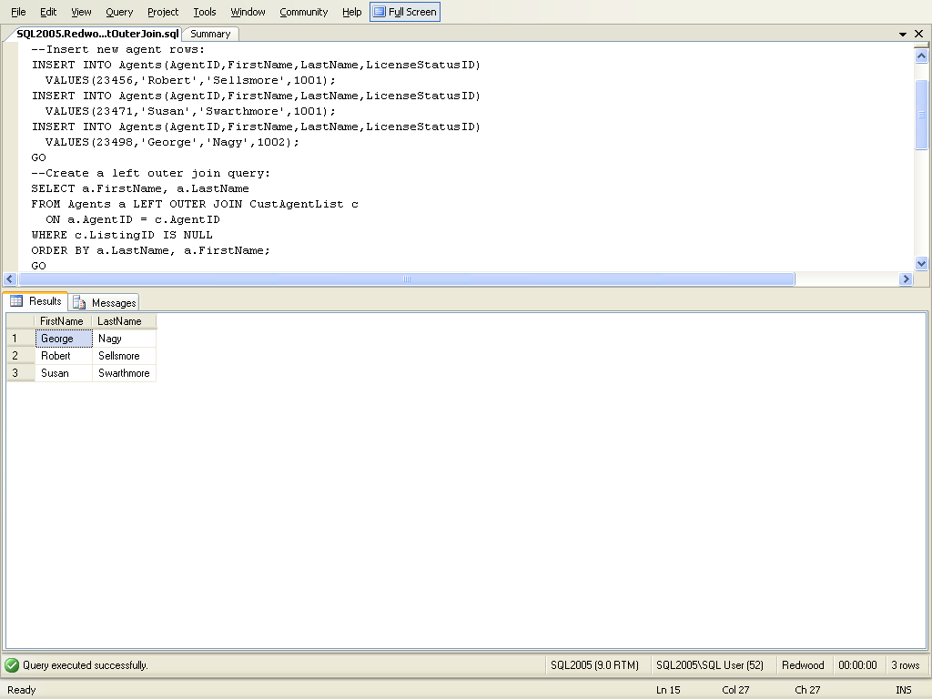
First lets insert some records so that we can show the left outer join. We need to insert some new agents ... These folks will not have sold anything yet since they are new agents. You can just add one new agent if you want to. Make sure you don’t have trigger that prevents agents being added or constraints under key folder
6-<number>

Slide 99
find the agents (firstname, lastname) that don’t have any customers, remember you can use the where clause to control who gets displayed, also display agents in alphabetical order last name followed by first name. Use CustAgentList table
Format:
Select * from table1
Left Outer Join table2 on table1.fieldname = table2.fieldname where ….. try to write the query above
6-<number>

Slide 100
Using a left outer join
agents don’t have any customers
6-<number>

Slide 101
This works also … there are a number of null fields that
you can check against sometime
select *
from agents
left outer join Custagentlist on agents.agentid = custagentlist.agentid
--where custagentlist.listingid IS NULL
where custagentlist.contactreason IS NULL
This also works …
select *
from agents
left outer join Custagentlist on agents.agentid = custagentlist.agentid
--where custagentlist.listingid IS NULL
--where custagentlist.contactreason IS NULL
where customerid IS NULL
6-<number>

Slide 102
List how many listings each agent (list their first and last name) has, even if it is zero, also order the output from least listings to greatest listings try to write this query, answer next slide
6-<number>

Slide 103
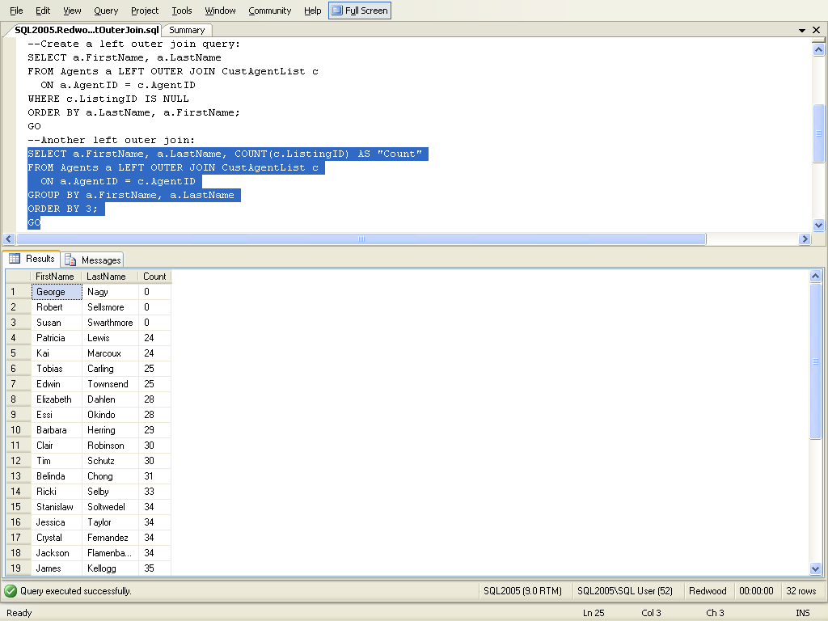
6.8 Showing non-matching rows with a COUNT function
zero count indicates no match in a corresponding table
Number of listings
that an agent has
6-<number>

Slide 104
Let’s try a few more using the Coffee DB
Your boss wants to set up training class for all of the employees that do not have any customers, he wants you to get him that list
write the sql command, solution next slide
6-<number>

Slide 105
select * from employees left join orders on employees.EmployeeID = orders.EmployeeID where orders.orderid IS NULL order by employees.employeeID
6-<number>

Slide 106
Let’s try another one
Your boss wants a list of all of the customers that have no employees helping them; so that he can give them to the employees with no customers.
First insert the sql command below.
insert into orders values (5678, getdate(), '7878', 33316, NULL)
Answer next slide
6-<number>

Slide 107
select * from orders left join employees on employees.EmployeeID = orders.EmployeeID where orders.employeeid IS NULL order by employees.employeeID or select * from orders where employeeID IS NULL
6-<number>

Slide 108
We have been using equijoin (=) everywhere lets
try non-equijoin
Between, <, <=, >, >=, <>
6-<number>

Slide 109
Set Operators
6-<number>

Slide 110
Set Operations … with select
Except
Intersect
Union
Union All
6-<number>

Slide 111
EXPLORE SQL set operators between queries
Set operator | Description
EXCEPT (it is called MINUS in Oracle) | Returns the rows that remain when the rows retrieved by a second query are removed from the rows retrieved by the first query.
INTERSECT | Returns rows that are retrieved by both queries.
UNION | Returns all unique rows retrieved by the queries.
UNION ALL | Returns all the rows retrieved by the queries, including any duplicate rows.
Easier to see with examples
6-<number>

Slide 112
An Example – Union 2 real estate agencies
select agentid, firstname, lastname, birthdate
from agents
union
select realtorid, fname, lname, DOB
from nevadarealtors
6-<number>

Slide 113
Except - Returns the rows that remain when the rows retrieved by a second query are removed from the rows retrieved by the first query. Oracle calls it MINUS
Table1 = A, C, D, F, G, H, Z
Table2 = A,B,C,H,W
Select * from table 1
Except
Select * from table2
Return= D,F,G,Z values in table1
that are not in table2
Table1 = A, C, D, F, G, H, Z
Table2 = A,B,C, H,W
6-<number>

Slide 114
What does this give me
select firstname, lastname, customerid from agents a
left outer join custagentlist cal on a.agentid = cal.agentid
Except
select firstname, lastname, customerid from agents a
Inner join custagentlist cal on a.agentid = cal.agentid
… values in table1 that are not in table2 … Returns the rows
that remain when the rows retrieved by a second query are
removed from the rows retrieved by the first query. Answer next slide
6-<number>

Slide 115
What does this give me
select firstname, lastname, customerid from agents a
left outer join custagentlist cal on a.agentid = cal.agentid
… agents with all of its customers and agents without customers
Except
select firstname, lastname, customerid from agents a
Inner join custagentlist cal on a.agentid = cal.agentid
…. agents and all of its customers
… values in table1 that are not in table2 … Returns the rows
that remain when the rows retrieved by a second query are
removed from the rows retrieved by the first query.
6-<number>

Slide 116
Agents that have no contacts
select firstname, lastname, customerid from agents a
left outer join custagentlist cal on a.agentid = cal.agentid
except
select firstname, lastname, customerid from agents a
join custagentlist cal on a.agentid = cal.agentid
Gives you list of agents and contacts;
Even if they don’t have a customer
that they are working with
Agents that have contacts
6-<number>

Slide 117
Gives you the Same answer
select firstname, lastname, customerid from agents a
left outer join custagentlist cal on a.agentid = cal.agentid
where customerid is null
Agents that don’t have any customers/contacts
6-<number>

Slide 118
Subqueries
6-<number>

Slide 119
Subqueries
a query inside of another query, option to use aggregates in the where clause when you use subqueries
You can use subqueries not just with select but with insert, delete and update
6-<number>

Slide 120
Subqueries – a query that is contained within another SQL statement; a complete select statement nested within another SQL statement; the subquery will execute first
2 subquery types:
1. uncorrelated (independent) (means the subquery can run by itself)
2. correlated (dependent) (means the subquery can not run by itself)
2 return types:
  return a single value – scalar
  return multi values (e.g. using:
in, any, all in the where clause)
6-<number>

Slide 121
Return a single value, we will start here
Here is the problem we want to solve ….. Your customer wants to live in Arcata and also want to have one of the newer homes in arcata … your query has to …. List properties that are younger than the average for all arcata properties, you want the report to include the address of the property and the yearbuilt
What do you want your subquery to tell you ???? The average age of the homes in Arcata
Try writing the inner query first and then test it, answer next slide
SUBQUERY FORMAT
Select .... From …
Where x comparision-operator (select …..)
6-<number>

Slide 122
query returns the average age of homes in Arcata + 18 years (returns 1 value --- kinda like calling a function)
Select AVG(YearBuilt) From Properties
Where City = ‘Arcata’)
Returns a
single value
SUBQUERY FORMAT
Select .... From …
Where x comparision-operator (select inner query)
Now try to finish the subquery, answer next slide

Slide 123
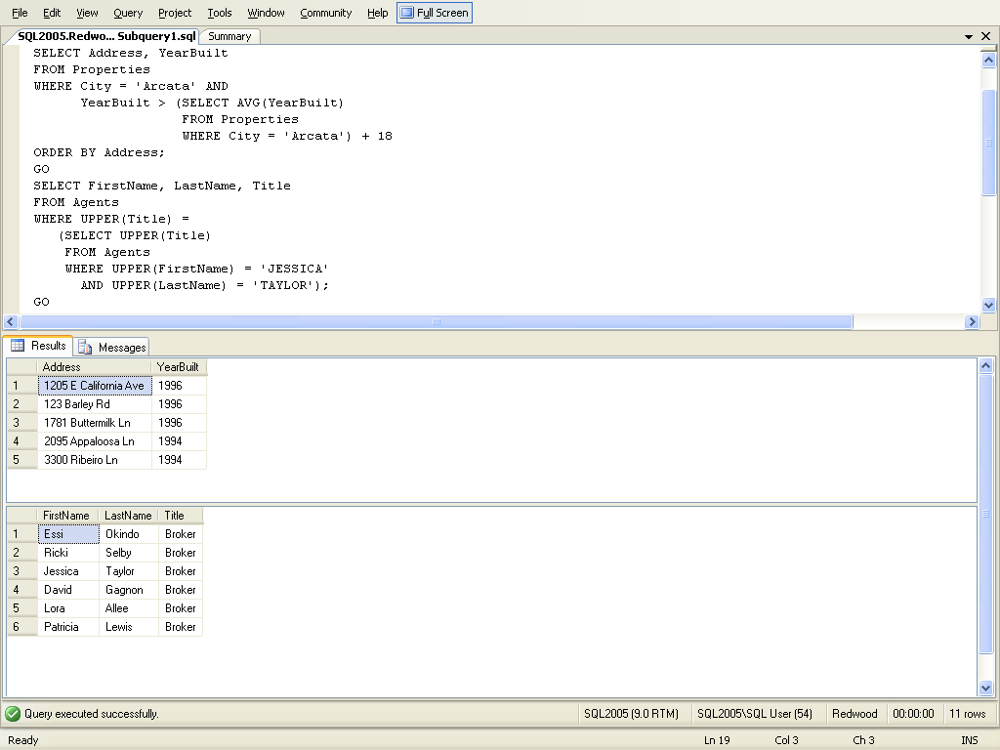
Returns a
single value
try inner select by itself first when
Building, inner query returns the average age of homes in Arcata (returns 1 value --- kinda like calling a function)
List properties that are at least 18 years
younger than the average for all arcata properties
6-<number>

Slide 124
You try one. Write a query that returns the first and last name of agents that have the same Title as jessia taylor, assume you do not know Jessica’s title … answer next slide first think about what do you want your subquery to tell you ??
Answer next slide
6-<number>

Slide 125
Returns folks that have the same
Title as jessia taylor,
6-<number>

Slide 126
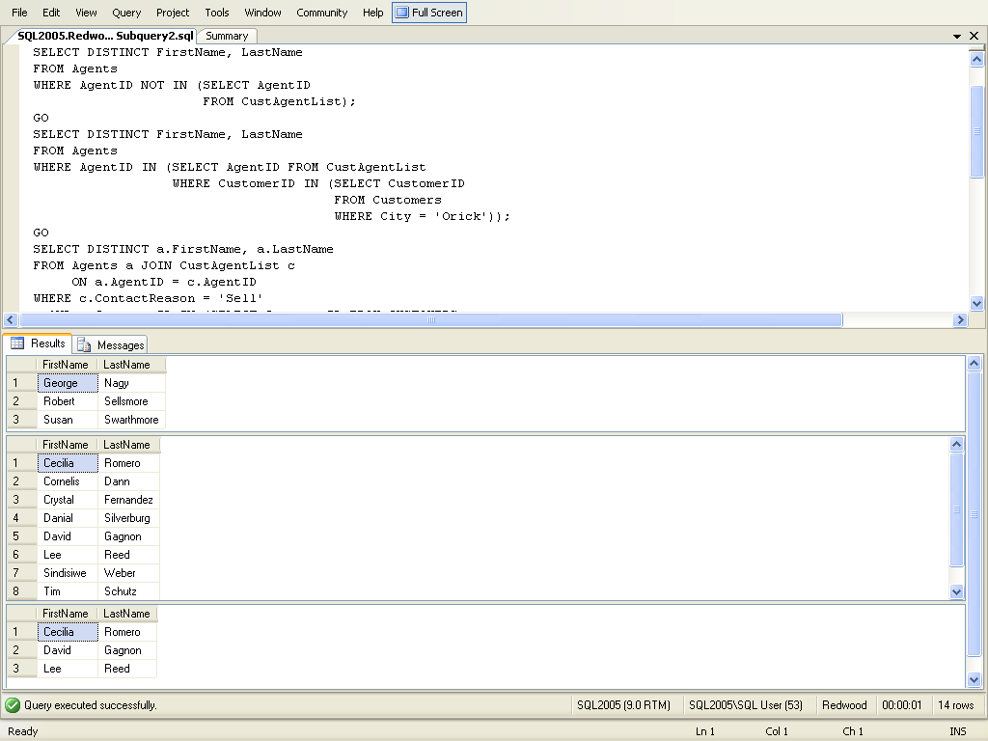
Agents that have no listings
agent’s with customers
All agents not in the list of agent’s with customers
6-<number>

Slide 127
Example below is just to show you that you can do a subquery inside of another subquery
Agents that have
Customers that live in orick
Customers that live in orick
6-<number>

Slide 128
Comparison operators and subquery
6-<number>

Slide 129
Comparison operators that introduce a subquery can be modified by the keywords ALL or ANY. SOME is an ISO standard equivalent for ANY. You can use SOME or ANY
6-<number>

Slide 130
Any and All operators and how we can use them in subqueries
6-<number>

Slide 131
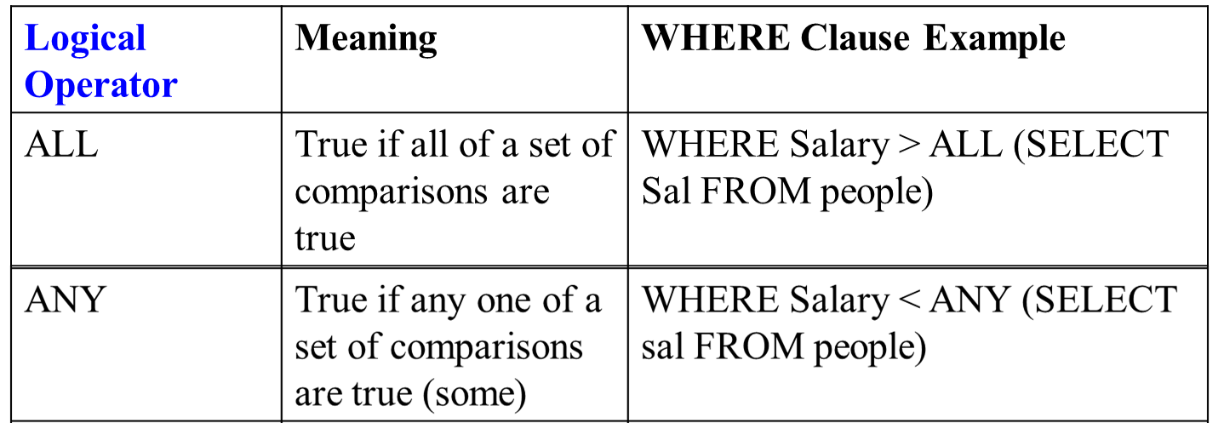
return multi values (more then 1 row) using in, not in, any, all in the where clause
Salary has to be larger then all of the salaries in the people table
6-<number>

Slide 132
ANY and ALL operator descriptions that can be used with the where clause
Operator | Meaning
=ANY | Equal to any value the subquery returns. It is the same as the IN operator.
<ANY | Smaller than the largest value the subquery returns.
>ANY | Larger than the smallest value the subquery returns.
>ALL | Larger than the largest value the subquery returns.
<ALL | Smaller than the smallest value the subquery returns.
I’ll show you one first
6-<number>

Slide 133
What if the agents work on different teams and you want to know …. all of the agents that make more then the highest paid agent on a certain team, in our example we will pick team 10
For those that make more you want to know, their agentid, their salary and their team
Remember we are using the Any and All operators in subquery
Answer next slide
6-<number>

Slide 134
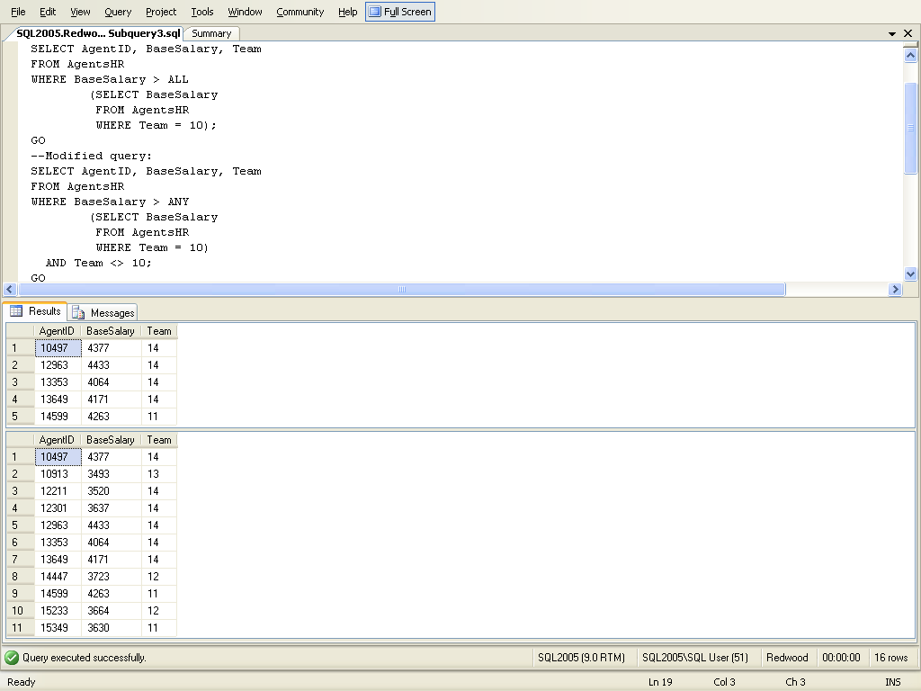
>ALL ------ Larger than the largest value the subquery returns.
3420
3838
3833
Subquery gets all salary from team 10, outer select lists base salaries, that are larger then this list
>ALL | Larger than the largest value the subquery returns.
Make more then 3838
6-<number>

Slide 135
What if the agents work on different teams and you want to know …. all of the agents that make more then the lowest paid agent on a certain team, in our example we will pick team 10
For those that make more you want to know, their agentid, their salary and their team
Remember we are using the Any and All operators in subquery
Answer next slide
6-<number>

Slide 136

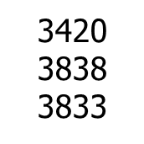
> Any – larger than the smallest
List anyone Larger then at least somebody (anybody) in the subquery
Another way to say it …..
List anyone larger then the smallest value in the subquery
6-<number>

Slide 137
correlated subquery queries are dependent, you will not be able to run the subquery by itself
6-<number>

Slide 138
Correlated subquery references columns in the outer query, the server executes the inner query once for every row in the outer query, you need an answer each time from the inner query. this makes them expensive to use
6-<number>

Slide 139
Question
Which properties have an asking price that is greater then the average price for their city (above average asking prices), you are only interested in cities of loleta, orick, trinidad
Asking price is in the listings table, City is in the properties table
Subquery determine the average asking price for each city
Basically you use the outer query to go through each row in the table and the inner query beings again
I will show you the solution for this one then you will try one by yourself
6-<number>

Slide 140
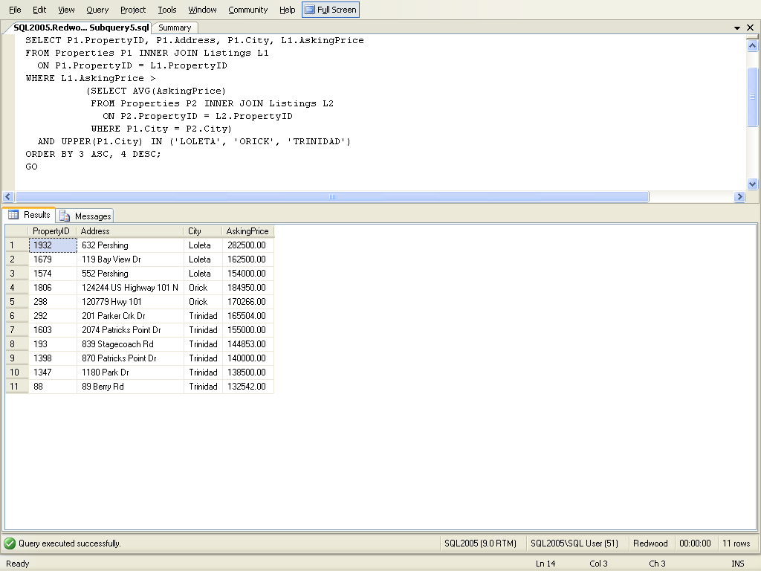
Average asking price for that city
Is that particular property more then that average
P1.City is from the outer query, so it cannot run independently
Which properties that are for sale that have an asking
price that is greater then the average price for their city (above average asking prices)

Slide 141
Average asking price for that city
Is that particular property more then that average
P1.City is from the outer query, so it cannot run independently
Which properties that are for sale that have an asking
price that is greater then the average price for their city (above average asking prices)

Slide 142
Now you try one …. What agents earn more than their group/team average (better than the average salary on their team) … answer next slide – use a Correlated subquery
6-<number>

Slide 143
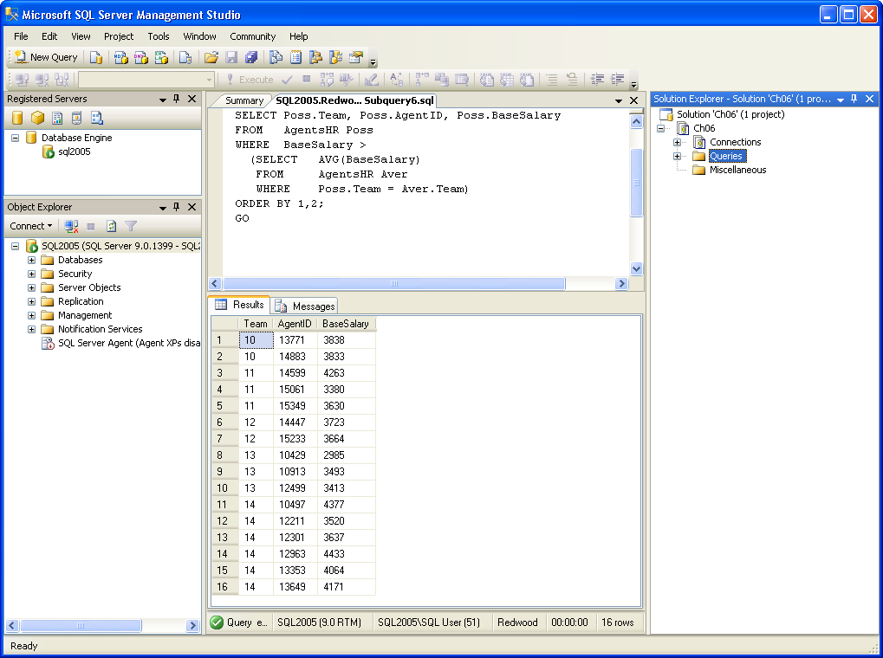
Agent’s salary
Agent’s team’s
Average
salary
the team members List agents that have an above average salary compared to the other members on their team
6-<number>

Slide 144
FYI: You can use subqueries not just with select but with insert, delete and update
6-<number>

Slide 145
Next section – Create View
Skip if need to do other things like roles/encrypt, XML and cascade delete
6-<number>

Slide 146
Creating and using views (predefined query – that gets a name, used with security roles, customize the perception each user has of the DB, virtual table)
Views (like everything else) can be done via the GUI or sql commands. Let’s take a look at the GUI one first
6-<number>

Slide 147
To create a view by using the Gui
In Object Explorer, expand the database where you want to create your new view.
Right-click the Views folder, then click New View….
In the Add Table dialog box, select the element or elements that you want to
include in your new view from one of the following tabs: Tables, Views, Functions,
and Synonyms.
Click Add, then click Close.
In the Diagram Pane, select the columns or other elements to include in the new view.
In the Criteria Pane, select additional sort or filter criteria for the columns.
On the File menu, click Save view name.
In the Choose Name dialog box, enter a name for the new view and click OK.
6-<number>

Slide 148
Create View viewname
[column-names] note [ ] indicates optional as subquery
[with check option];
Example: list of agents that are not brokers
Create view NonBrokers as select AgentID, LastName, FirstName, BirthDate, Gender, HireDate, Title, TaxID from Agents where upper(title) <> ‘BROKER’ with check option;
create a view by using SQL commands
Indicates that Only rows that satisfy the where
clause can be inserted, updated, deleted
6-<number>

Slide 149
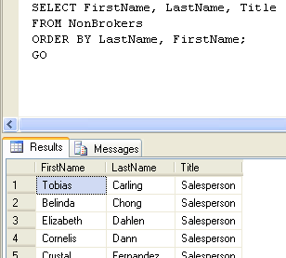
Displaying rows through the NonBrokers view
Use viewname instead
of tablename
6-<number>

Slide 150
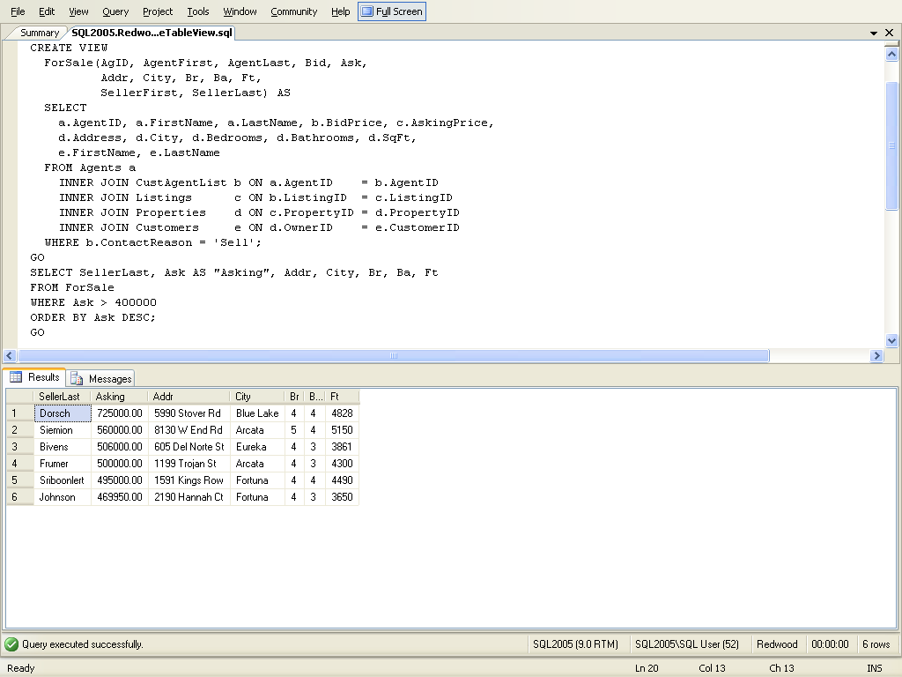
Creating a multiple table view joining five tables
this creates the ForSale view
this queries the view to produce the results below
6-<number>

Slide 151
stop
6-<number>

